Slide 1
Tutorial 1: Alignments
Anush Niranjan, Catherine Nguyen, and Jason Ellstrom

Slide 2
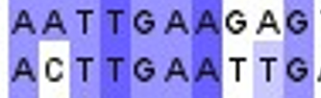
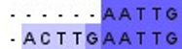
What is alignment?
Sequence alignment a powerful method to compare and detect related DNA, RNA, or protein sequences.
Example:
It is used to capture various facts and relationships about the aligned sequences.
Use case:
Phylogenetic trees
Developing homology models
Identifying sequence similarity
Unaligned
Aligned
Notes:
[1] https://www.ncbi.nlm.nih.gov/books/NBK464187/

Slide 3
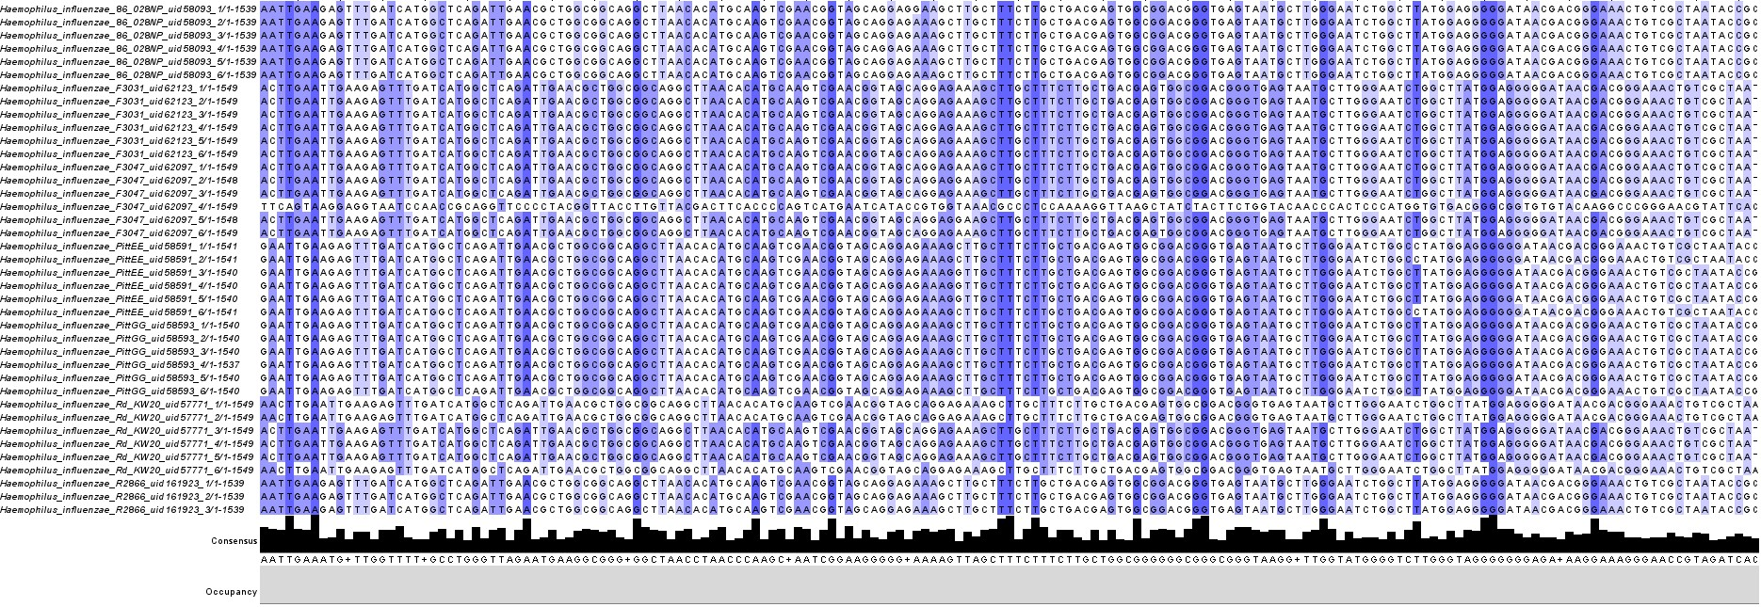
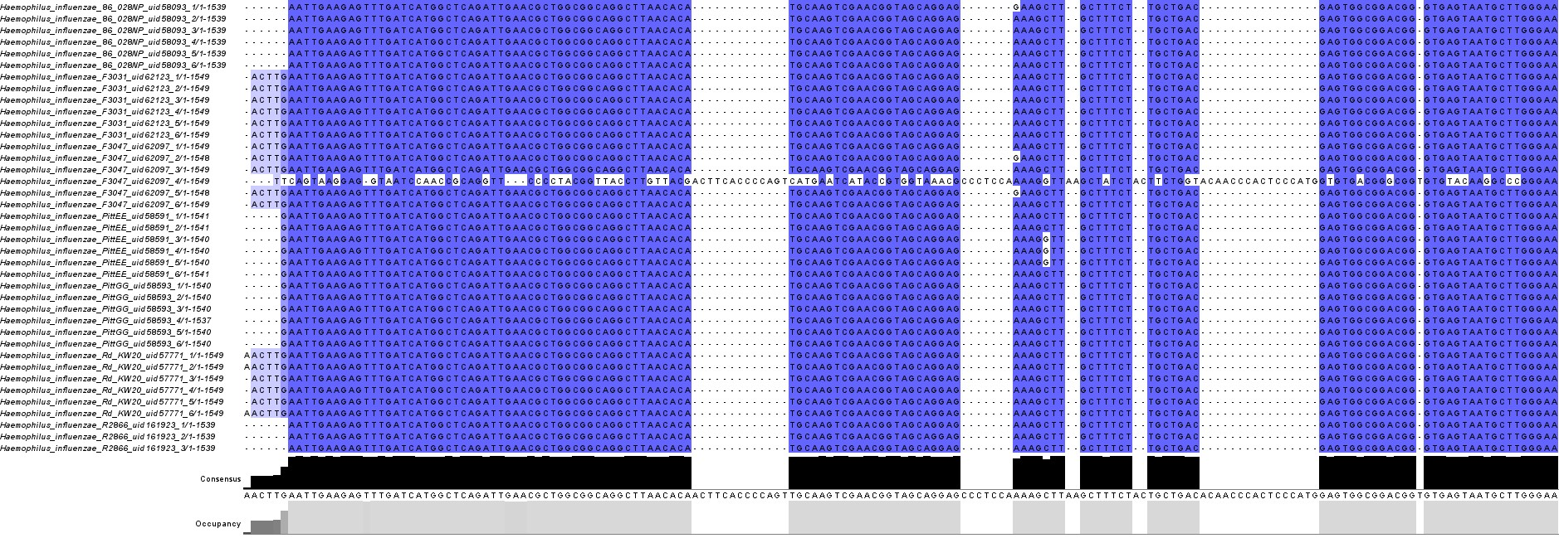
What is Multi Sequence Alignment?
Unaligned
Muscle Aligned
16S for Haemophilus influenzae
39 Sequences
Notes:
[1] https://www.ncbi.nlm.nih.gov/books/NBK464187/

Slide 4
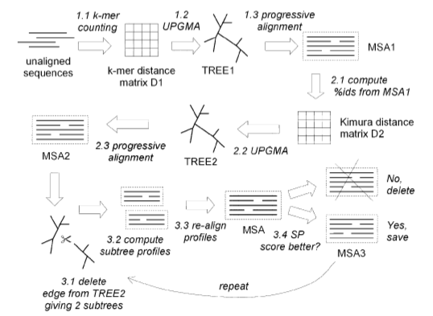
What is MUSCLE Alignment? [2, 3]
Multiple Sequence Comparison by Log-Expectation
Three-stage process
Draft Progressive
Improved Progressive
Refinement
Each stage has multiple steps
Figure 1: Flow map of MUSCLE alignment algorithm [2]
Notes:
Jason

Slide 5
MUSCLE Stage 1: Draft Progressive
Speed > Accuracy
K-mer distance calculated
Looks at subsequences of length k in each input sequence pair to calculate distance
Outputs distance matrix D1
D1 is clustered via unweighted pair group method with arithmetic mean (UPGMA)
Iterative method that groups together sequences based on distances
New distance matrix is created using means
Outputs binary tree TREE1
TREE1 is aligned
Process starts at generating profile at leaves and goes from child to parent
Uses Log Expectation method
LExy = (1 - fxG) (1 - fyG) log(sumi(sumj(fxi*fyj*pij/(pi*pj)))
Pairwise alignment of child profiles used to generate profile for parent
Outputs multiple alignment MSA1
Notes:
Jason
Involves p: probability of amino acid i and j being in sequence, the joint probability of i and j being aligned
x and y: column numbers in the first and second profiles, respectively
G: gap
f: frequency of the subscripts (like fxi is the frequency of i in column x)

Slide 6
MUSCLE Stage 2: Improved Progressive
Greater focus on accuracy
Kimura distance calculated
Looks at number of transitions and transversions in each input pair
Outputs distance matrix D2
D2 clustered by UPGMA
Same as in last stage
Outputs binary tree TREE2
TREE2 is aligned
Similar to last stage
Only look at branching orders that differ compared to TREE1
Outputs MSA2
Stage can be iterated
Algorithm can also be halted
Notes:
Jason
Transition is change between same type of amino acid (A <-> G, C <->T, transversion different type, A,G <-> C,T)

Slide 7
MUSCLE Stage 3: Refinement
An edge in TREE2 is selected
Delete edge to generate two subtrees
Edges are selected starting at the farthest away to the root
New profiles created for each tree
Profiles are realigned
Using same method as previous alignments
If score of new alignment is better, keep
Can be iterated until stopping condition
All edges being visited without a change
Convergence in the changes
User-defined max iterations
Notes:
Jason

Slide 8
What is MAFFT alignment?
MAFFT stands for Multiple Alignment with Fast Fourier Transform.
By utilizing the fast fourier transform, MAFFT aims to optimize protein and nucleotide alignments.
MAFFT is very useful for hard-to-align sequences such as those that contain large gaps.
Example: rRNA sequences containing variable loop regions
Notes:
Cat
https://mafft.cbrc.jp/alignment/software/
https://www.ncbi.nlm.nih.gov/pmc/articles/PMC135756/
http://evomics.org/resources/software/bioinformatics-software/mafft/
https://www.youtube.com/results?search_query=explain+maffta+alignment

Slide 9
What novel techniques does MAFFT use?
Fast Fourier Transform (FFT)
It is the technique used to rapidly identify homologous regions.
Simplified Scoring System
Performs well at reducing CPU time and increase accuracy of alignments especially for:
Sequence that have large insertions or extensions
Distantly related sequences of similar length

Slide 10
Fast Fourier Transform
Fast Fourier Transform: An amino acid sequence is converted to a sequence composed of volume and polarity values of each amino acid residue.
Why volume and polarity values?
The frequency of amino acid substitutions strongly depends on the difference of physico-chemical properties.
Substitutions between physio-chemically similar amino acids tend to preserve the structure of proteins

Slide 11
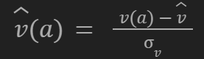
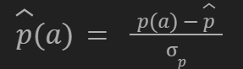
Fast Fourier Transform Cont.
Let there be an amino acid a, which is assigned to a vector whose components are the volume value v(a) and polarity value p(a).
Normalized forms of these values:
Volume:
Polarity:
Where overbar denotes the average over 20 amino acids and σ notes standard deviations.
Notes:
SIGMA

Slide 12
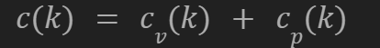
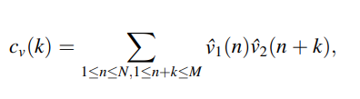
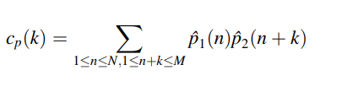
Fast Fourier Transform Cont.
The correlation value c(k) represents the degree of similarity between two amino acid sequences with the positional lag of k siltes.
Correlation of Volume Component Correlation of Polarity Component
Notes:
Where c_v(k) and c_p(k) are the correlations of volume component and polarity component, respectively, between two sequences.
Make notes for this

Slide 13
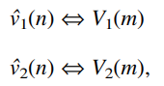
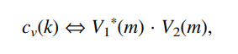
Fast Fourier Transform Cont.
Considering N ≅ M, FFT reduces the CPU time of this calculation from O(N^2) to O(N log N).
The same calculations can be done for the polarity component.
Fourier Transform:
Fourier Transformed Correlationsion Result:
Notes:
Double arrows represents transform pairs and asterick denotes complex conjugation

Slide 14
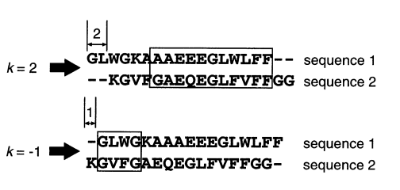
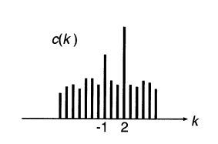
Fast Fourier Transform Cont. - Finding Homologous Segments
Figure 2. Result of FFT Analysis [5]
Figure 3. Sliding Window Analysis and Positions of Homologous Blocks are Determined [5]
Notes:
In the first graph

Slide 15
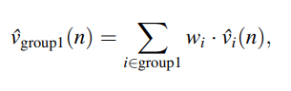
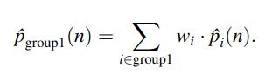
Fast Fourier Transform Cont. - Extending to Group-to-Group Alignments
The previous procedures can be extended to a group-to-group alignment by replacing the normalized volume value v_1(n) from the previous correlation functions.
Notes:
Can be applied to nucleotide sequences by converting a sequence to a sequence of four-dimensional vectors whose components are the frequencies of A T G and C at each column instead of volume and polarity values.

Slide 16
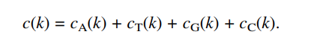
Fast Fourier Transform Cont. - Applicable to Nucleotides
The Fast Fourier Transform is also applicable to nucleotide sequences using the nucleotide bases (A, T, G, and C) instead of volume and polarity values.
The correlation between two nucleotide sequences would be as follows:

Slide 17
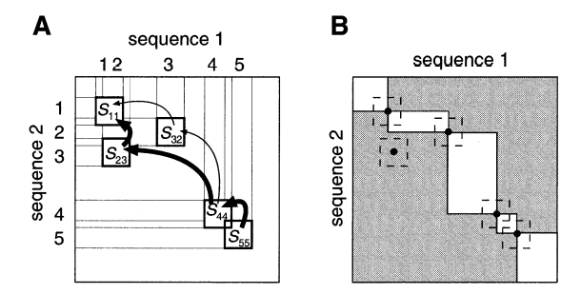
Homology Matrix
By applying the standard dynamic programming to the matrix, the optimal path is obtained.
Figure 4: (A) Segment-Level Dynamic Programming; (B) Reducing the Area for DP on a Homology Matrix [5]
Notes:
Optimal path correlates to the optimal arrangement of homologous segments.
What is dynamic programming - high speed computer program applicable to large-scale problems

Slide 18
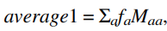
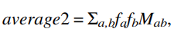
2. Scoring System - Scoring System
To increase the efficiency of alignment, the scoring system was modified from the Needleman-Wunsch algorithm.
Adopted a normalized similarity matrix M_ab (where a and b are amino acids) that have both positive and negative values.
Similarity Matrix Calculation:
Average Value Calculations:
Notes:
Cat

Slide 19
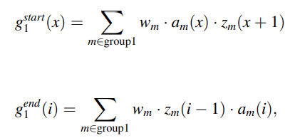
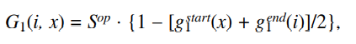
2. Scoring System - Gap Penalty
Scoring system was designed to allow for large gaps.
This simpler gap penalty formulation allows CPU time to be considerably reduced while maintaining the accuracy of resulting alignments as comparable with other existing scoring systems.
Gap Penalties
Gap Start and Gap End Penalty Calculations
Notes:
Needleman–Wunsch

Slide 20
Comparison
MUSCLE
Pros:
Significantly faster than other methods
High accuracy
Can be modified for speed/accuracy tradeoffs
Cons:
Relatively high spatial complexity
MAFFT
Pros:
Reduced CPU time
Maintains accuracy as compared to other accurate algorithms
Works best with long sequences
Cons:
Other algorithms/techniques can probably outperform MAFFT when aligning smaller sequences.

Slide 21
Muscle/MAFFT Alignment Walkthrough
https://github.com/catwinguy/ECES450650-Tutorial1

Slide 22
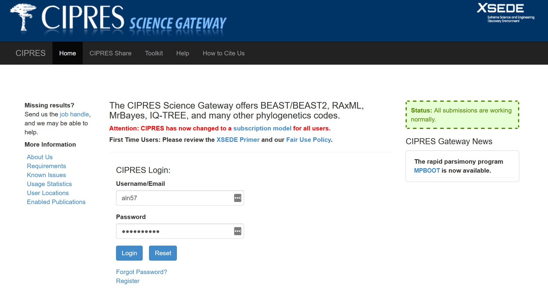
How to use CIPRES
https://www.phylo.org/portal2/login!input.action

Slide 23
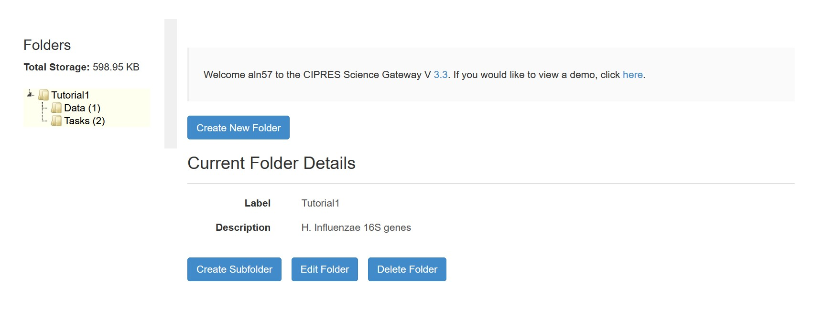
Create a New Folder
1
2

Slide 24
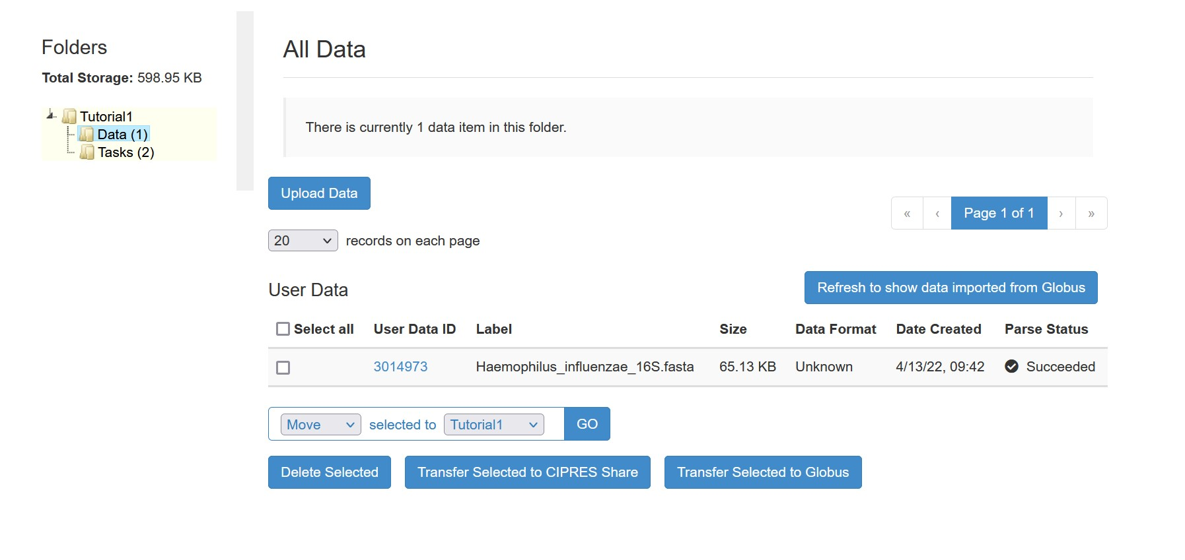
Upload Sequence Data
3
4
5

Slide 25
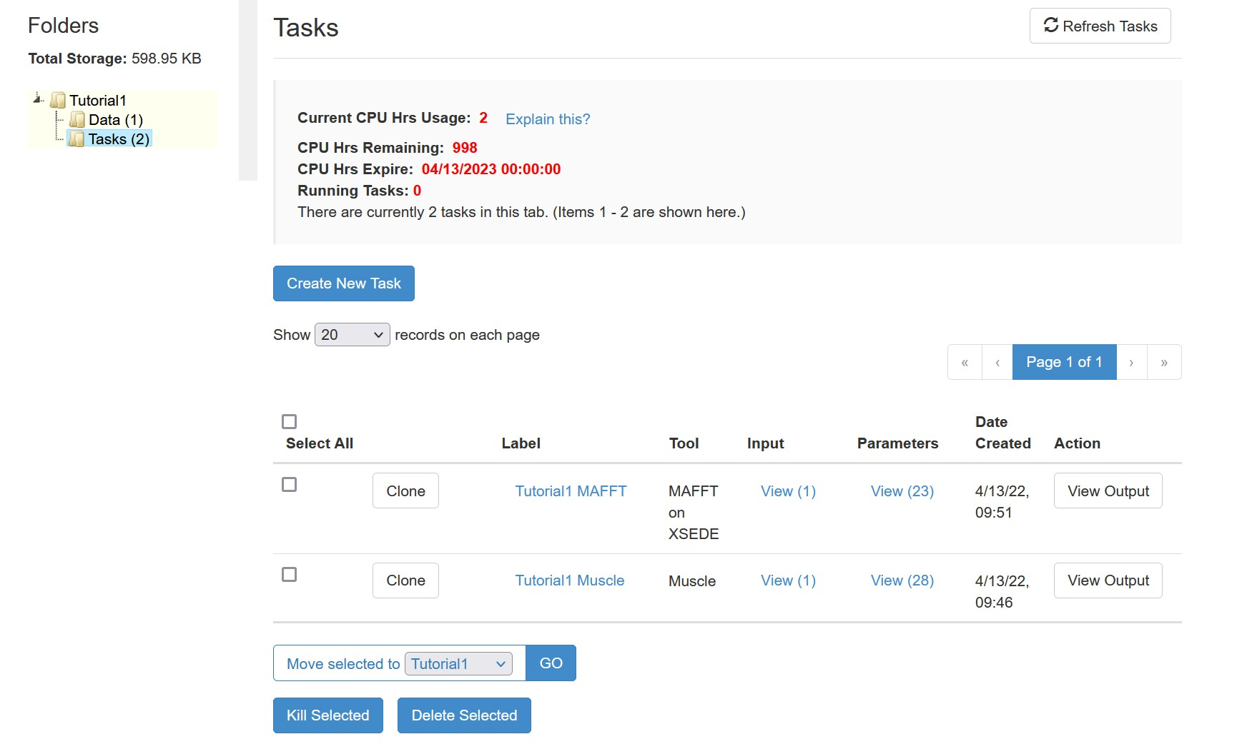
Create New Task
6
7

Slide 26
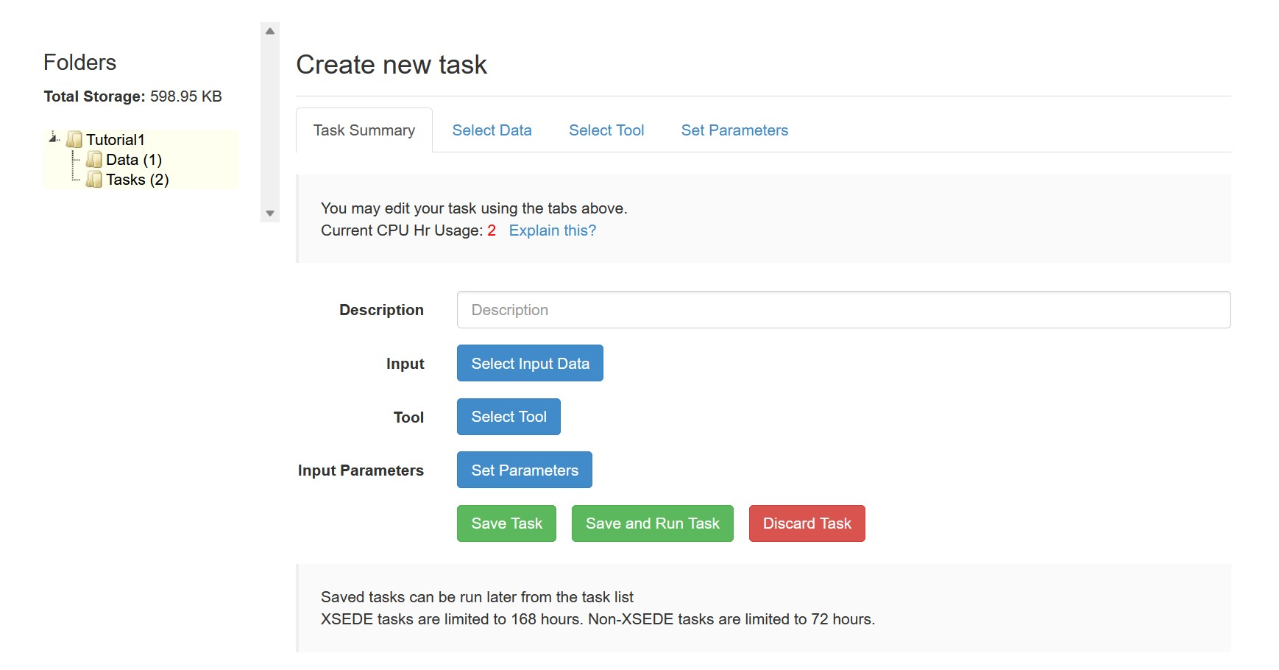
Setting Up a Task
8

Slide 27
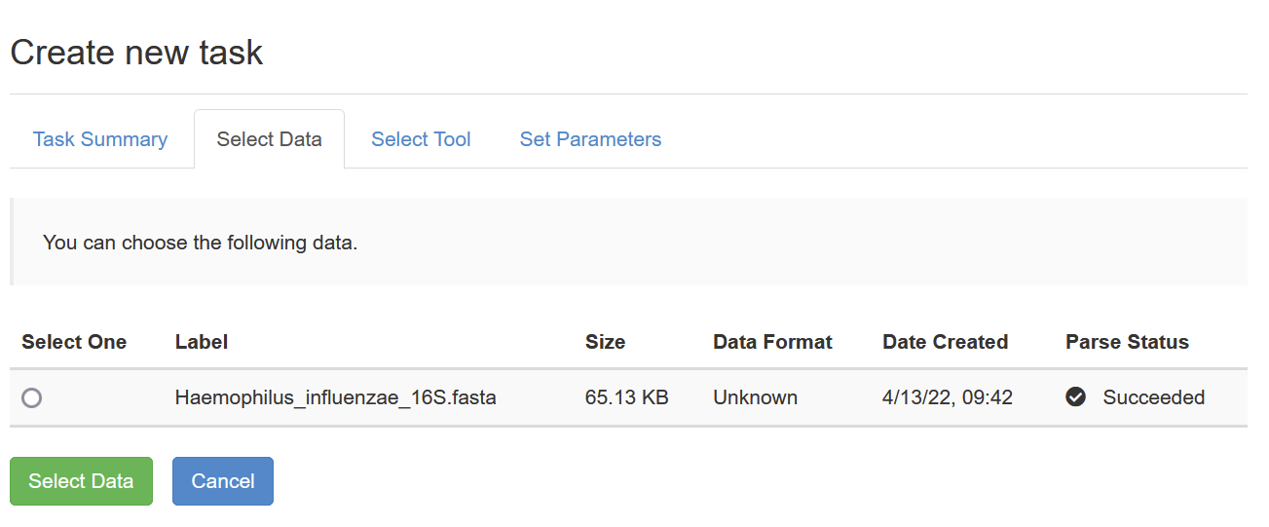
Import Sequence Data

Slide 28
Setting Up a Task
9

Slide 29
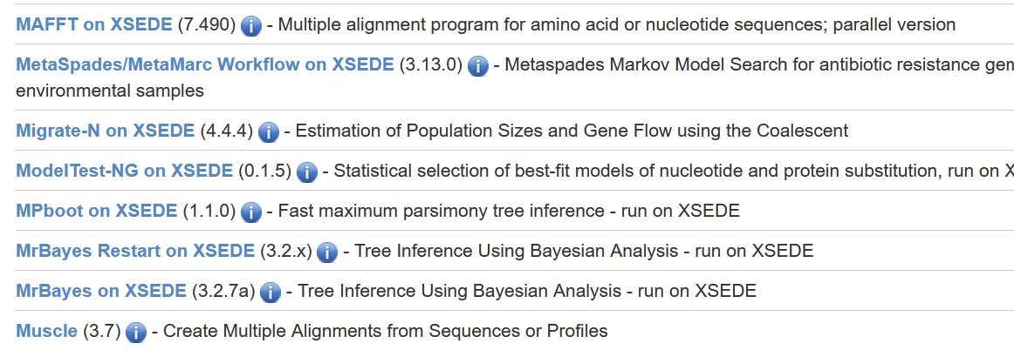
Selecting Tool

Slide 30
Setting Up a Task
10

Slide 31
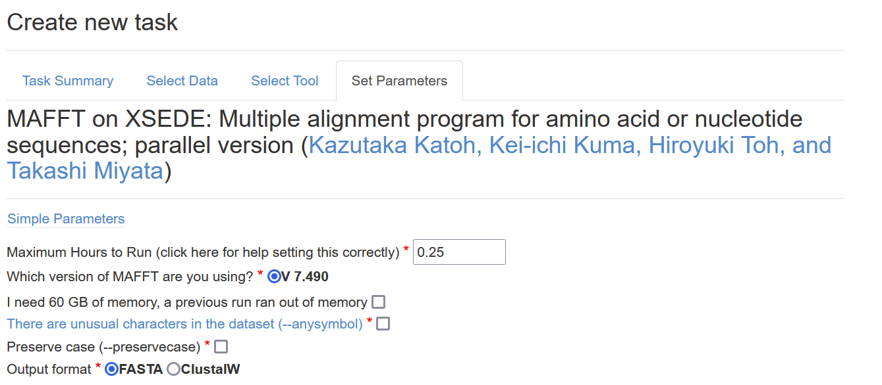
Set Parameters for MAFFT
51 Parameters preset for MAFFT except for the two mention below
Check to run
Check to run

Slide 32
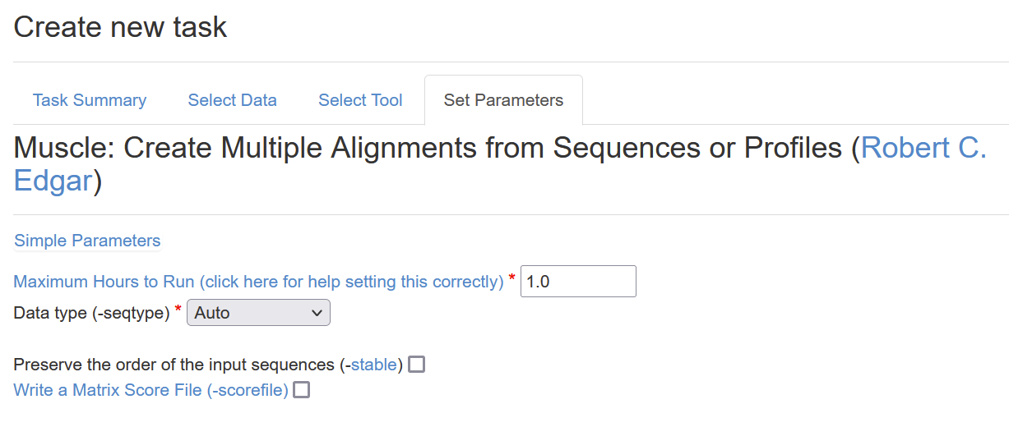
Set Parameters for Muscle
47 Parameters preset for Muscle algorithm

Slide 33
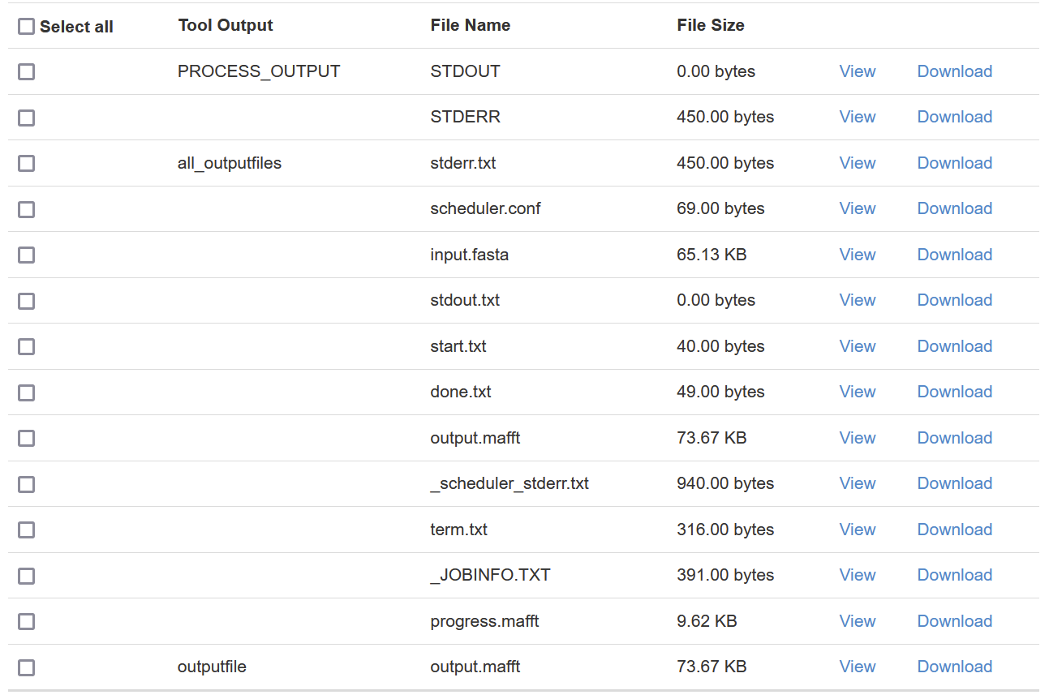
Analyze Output for MAFFT

Slide 34
Visualize Unaligned multi-sequence
*Visualized using JalView

Slide 35
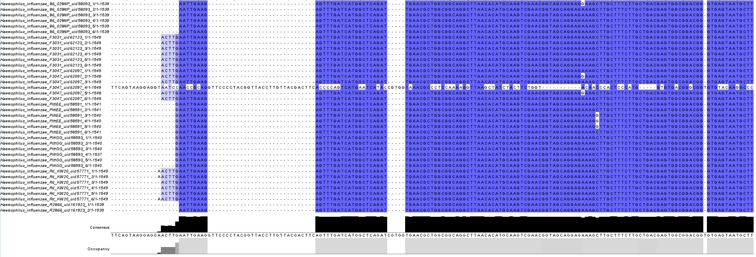
Visualize MAFFT Output

Slide 36
Visualize Muscle Output

Slide 37
Runtime for MAFFT and Muscle alignment
We look at the Start and Done files for runtime
Algorithm | Runtime (secs) | Cores
MAFFT | 5 | 8
Muscle | 7 | 1

Slide 38
References
[1] https://www.ncbi.nlm.nih.gov/books/NBK464187/
[2] https://www.ncbi.nlm.nih.gov/pmc/articles/PMC390337/pdf/gkh340.pdf
[3] https://bmcbioinformatics.biomedcentral.com/track/pdf/10.1186/1471-2105-5-113.pdf
[4] http://evomics.org/resources/software/bioinformatics-software/mafft/
[5] https://www.ncbi.nlm.nih.gov/pmc/articles/PMC135756/pdf/gkf436.pdf

Slide 39
Thank you!

